Slide 1




PROJECT BRIEF · GRADUATE INTERNSHIP
Functional Visual Search
& Recommendation Prototype
Visual Search & Inspiration Experience · Pilot Phase
Client: Corona · Vajillas Corona
Project: Digital Visual Search & Inspiration Experience
INNOVATION & DIGITAL TRANSFORMATION
PILOT PHASE
GRADUATE INTERN

Slide 2


Visual Search & Recommendation
Context and objective of the project
Client: Corona · Vajillas Corona | Project: Digital Visual Search & Inspiration Experience | Stage: Pilot / PoC | Role: Graduate intern
WHY THIS PROJECT
Why are we doing it?
The Innovation & Digital Transformation team is designing the future of the shopping experience. Before any deep integration into the technology core of vajillascorona.com.co, we will run a market experiment to validate the traction and usability of a new intelligent tool.
OBJECTIVE OF THE INTERNSHIP
What are you going to build?
Design and develop a 100% functional and automated web prototype (No-Code / Low-Code or agile development) that lives on its own standalone local URL. It must simulate the final experience, handle interactions through AI and, only in the final step, redirect the customer to the purchase links of the official store vajillascorona.com.co.

Slide 3
Visual Search & Recommendation
Unified scope of the solution
Phase: Pilot | Channel: Web · Mobile-first | Environment: Standalone URL, outside the store core
01
Immediate mobile-first access
Access
A web page that works instantly in the browser, with no application to download.
02
Intelligent search
Core engine
The user uploads a photo of their tableware or types a description to find the exact Corona pieces.
03
Personalised inspiration
Recommendation
The system asks a few simple questions to generate moodboards and style recommendations.
04
Direct conversion
Checkout
It connects the experience to the shopping cart by redirecting to the official store.

Slide 4
Visual Search & Recommendation
Key features required
Scope: 3 automated capabilities | Delivery: Working prototype on a single URL
SCOPE IN — 3 AUTOMATED FEATURES
01
Visual & multimodal search
The main engine. It processes photos uploaded by the user, reference images or keywords to find exact catalogue products and generate moodboards.
02
Style diagnosis
Through a short brief or quick questionnaire, it turns the search into a visual space-redesign experience and generates moodboards.
03
Integrated checkout
The result of the inspiration connects directly with the purchase, taking the user to the real product detail page (PDP) with no barriers.

Slide 5

Visual Search & Recommendation
Technical architecture of the prototype
Approach: Fast validation | Constraint: No integration with the store core | Budget: USD 40 in API credit
EXTERNAL OPERATION
Where does it live?
The prototype will not touch the source code, servers or transactional databases of vajillascorona.com.co. It will live in a local PoC environment.
AGILE AI INTEGRATION
What are you allowed to use?
The use of commercial image-recognition and generative-AI APIs is allowed and encouraged, to solve visual search and recommendation quickly and efficiently. An OpenAI API key with USD 40 of credit will be provided for development.
PORTFOLIO OF THE PoC
What data do you work with?
The portfolio to be recognised is a sample of 20 dinnerware sets that must have pages within vajillascorona.com.co. The graphic, visual and descriptive content is to be extracted from those pages.
Commercial AI APIs orchestrated from an external prototype environment

Slide 6
Visual Search & Recommendation
User experience flow
Entry point: One single URL | Design: Mobile-first, frictionless
01
Upload or search
Photo or text reference
The customer starts from what they already have at home, or from an idea in words.
02
Style questions
Quick preferences
A few simple questions narrow the search and capture the style the customer is after.
03
Explore
Moodboard & Mix and Match
The system returns exact pieces, complementary items and a visual board to explore.
04
Buy
Add to cart and pay
The chosen piece links out to its real product page in the official store.
END TO END
The flow is designed to be intuitive and frictionless, from inspiration to conversion, all within a single mobile-first URL.

Slide 7
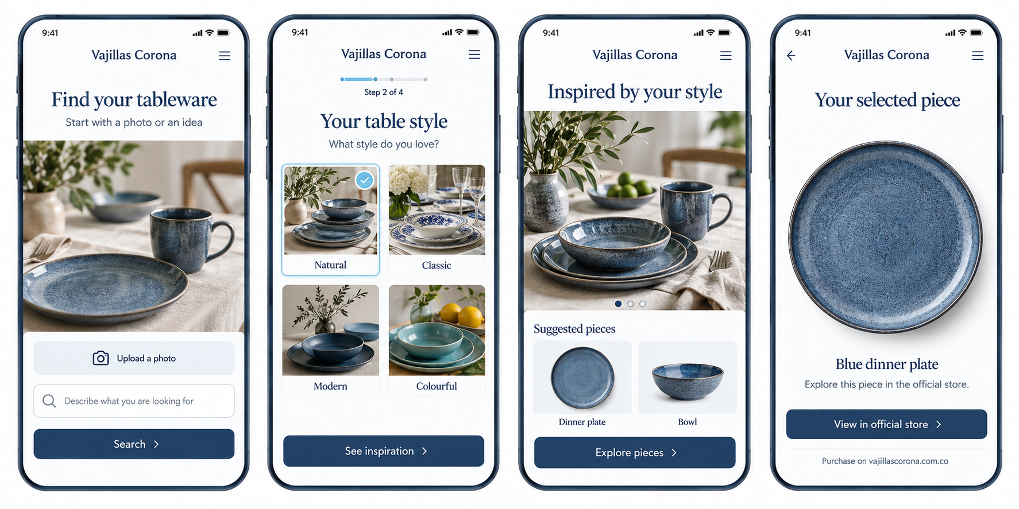
Visual Search & Recommendation
Prototype mockup: the mobile experience
Visual concept. Product images are illustrative. Checkout takes place in the official store.
Notes:
Conceptual mockup of the intended prototype, not a screenshot of a working product. The four screens illustrate photo or text search, a short style questionnaire, personalised inspiration and a link to the official store. Product images are AI-generated illustrations and do not represent verified items in the 20-set pilot catalogue. The interface mockup is an embedded image. Slide titles and explanatory text remain editable. Image generated with the built-in image generation tool.

Slide 8
Thank you
R&D | AI – Innovation & Digital Transformation
Vajillas Corona · Graduate internship brief · Pilot Phase

